Slide 1

Fundamentals of Artificial Intelligence
Farian S. L Ishengoma

Slide 2
Natural language processing
Language models
Text classification
Information retrieval
Information extraction
Machine translation

Slide 3

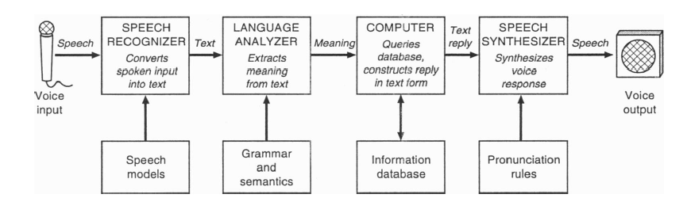
Human machine dialogue

Slide 4
Levels of Natural language processing (NLP)
Level 1 – Speech sound (Phonetics & Phonology)
Level 2 – Words & their forms (Morphology, Lexicon)
Level 3 – Structure of sentences (Syntax, Parsing)
Level 4 – Meaning of sentences (Semantics)
Level 5 – Meaning in context & for a purpose (Pragmatics)
Level 6 – Connected sentence processing in a larger body of text (Discourse)

Slide 5
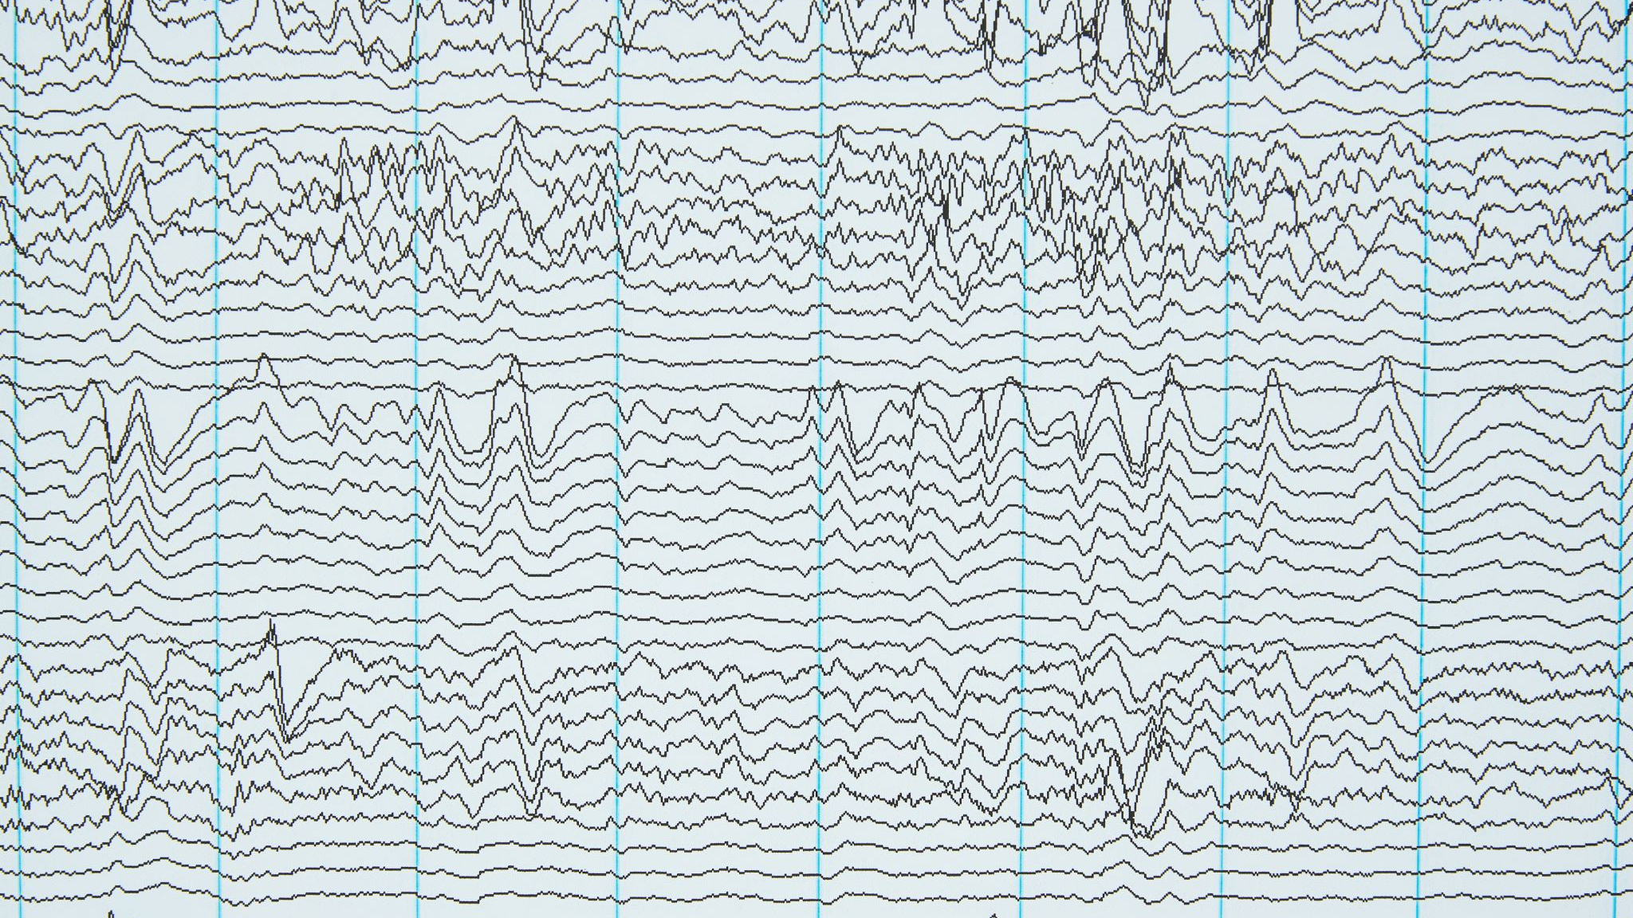
Levels of NLP
(see page 291 for more details)
Phonetics and Phonology:
  This is the lowest level of NLP, where the focus is on the sounds of language.
  Phonetics deals with the physical properties of speech sounds, while phonology deals with the study of the sound patterns of language.
  An example of this is speech recognition software that transcribes spoken language into text.
  This requires the software to be able to identify and distinguish between different speech sounds, even if they are pronounced slightly differently by different speakers.
Morphology:
  This level of NLP deals with the study of word structure, including the internal structure of words and how they are formed from smaller units known as morphemes.
  For example, the word "unhappy" is made up of the prefix "un-" and the root "happy". NLP algorithms can use this knowledge to generate new words, such as "unhappily".
Syntax:
  This level of NLP deals with the study of sentence structure, including how words are combined to form phrases and how phrases are combined to form sentences.
  For example, the sentence "The cat sat on the mat" has a simple subject-verb-object structure. NLP algorithms can analyze the structure of sentences to understand their meaning and to generate new sentences that follow the same structure.

Slide 6
Cont.
Semantics:
  This level of NLP deals with the study of meaning in language, including the meaning of words, phrases, and sentences.
  It includes understanding the relationships between words and how they are used in context.
  For example, a search engine might use NLP algorithms to analyze the meaning of a user's search query and return results that are relevant to the user's intent, even if the query doesn't contain the exact words that are being searched for.
Pragmatics:
  This level of NLP deals with the study of language use in context, including the interpretation of language based on the speaker's intentions, the listener's knowledge, and the context in which the language is used.
  For example, a chatbot might use NLP algorithms to understand the context of a user's message and respond appropriately. If a user says, "I'm hungry", the chatbot might respond with a list of nearby restaurants, even if the message doesn't explicitly request this information.
Discourse:
  This is the highest level of NLP, where the focus is on understanding larger units of language, such as texts or conversations. Discourse analysis involves analyzing the structure, coherence, and meaning of larger units of language beyond individual sentences.
  For example, an NLP algorithm might analyze a news article to identify the main topics and themes discussed or analyze a conversation between two people to understand the overall flow of the conversation and the roles of each speaker.

Slide 7
Language models
Language models (LM) are a type of artificial intelligence (AI) model that is designed to understand and generate human language.
Examples of LM are
OpenAI's GPT-3:
GPT-3 (Generative Pre-trained Transformer 3) is a state-of-the-art language model developed by OpenAI.
It uses deep learning techniques to generate human-like text, answer questions, and perform other natural language processing tasks.
Google's BERT:
BERT (Bidirectional Encoder Representations from Transformers) is a pre-trained language model developed by Google.
It uses deep learning techniques to understand the context and meaning of words in sentences and is used for tasks such as sentiment analysis and question answering.

Slide 8
Cont.
Facebook's RoBERTa:
RoBERTa (Robustly Optimized BERT approach) is a language model developed by Facebook that is based on BERT.
It is trained on a larger quantity of data and uses additional training techniques to improve performance on natural language processing tasks.
AllenNLP's ELMO:
ELMO (Embeddings from Language Models) is a language model developed by AllenNLP.
It uses a deep bi-directional LSTM to learn word representations that capture context and meaning in sentences.
Hugging Face's Transformer-XL:
Transformer-XL is a language model developed by Hugging Face.
It uses a transformer architecture with an extended memory to handle longer text sequences and improve performance on natural language processing tasks.

Slide 9
Text classification
Text classification, also known as text categorization,
is a natural language processing (NLP) technique that involves classifying a piece of text into one or more predefined categories based on its content
The goal of text classification is to automatically assign labels or categories to text documents,
such as emails, news articles, or customer feedback, based on their content.
There are two main types of text classification:
Binary classification and
Multiclass classification.

Slide 10
Binary classification
Binary text classification is a type of text classification task that involves assigning one of two possible labels or categories to a text document based on its content.
The two possible labels are usually binary, meaning they represent opposite or complementary categories, such as positive/negative.
Binary text classification is typically done using machine learning algorithms, such as logistic regression, support vector machines (SVM), or neural networks

Slide 11
Example of Binary Classification
Sentiment analysis:
Classifying social media posts, product reviews, or customer feedback as positive or negative.
Spam filtering:
Classifying emails as either spam or not spam based on their content.
Fraud detection:
Classifying credit card transactions as legitimate or fraudulent based on their text descriptions.
News article classification:
Classifying news articles as real or fake news based on their content.
Legal document classification:
Classifying legal documents as relevant or irrelevant to a specific legal case based on their content.

Slide 12
Multiclass classification
Multiclass classification
  is a task in NLP that involves predicting a category or label for a given text document from a set of multiple possible categories.

Slide 13
Example of Multiclass classification
Sentiment analysis:
This is a task of classifying text documents into different sentiment categories, such as positive, negative, and neutral.
For instance, a restaurant review classification system could classify reviews as "positive" if the overall sentiment is positive, "negative" if the sentiment is negative, and "neutral" if there is no clear sentiment.
News categorization:
This is a task of categorizing news articles into different categories, such as politics, sports, business, and entertainment.
For example, a news aggregator system could classify news articles into these categories based on the content of the article.
Topic modeling:
This is a task of clustering text documents into different topics or themes.
For instance, a topic modeling system could classify documents into topics such as science, technology, history, and art, based on the words and phrases present in the text.

Slide 14
Cont.
Language identification:
This is a task of identifying the language of a given text document.
For example, a language identification system could classify text documents as English, Spanish, French, or German, based on the language-specific features present in the text.
Spam filtering:
This is a task of classifying emails into different categories, such as spam and non-spam.
For instance, an email filtering system could classify emails as "spam" if they contain unsolicited or unwanted content, and "non-spam" if they are legitimate emails.

Slide 15

Information retrieval
Information retrieval (IR) is a subfield of NLP that involves searching for relevant information within a collection of documents or text data.
  The goal of IR is to retrieve a subset of documents that are most relevant to a user's query, given a large collection of documents.

Slide 16
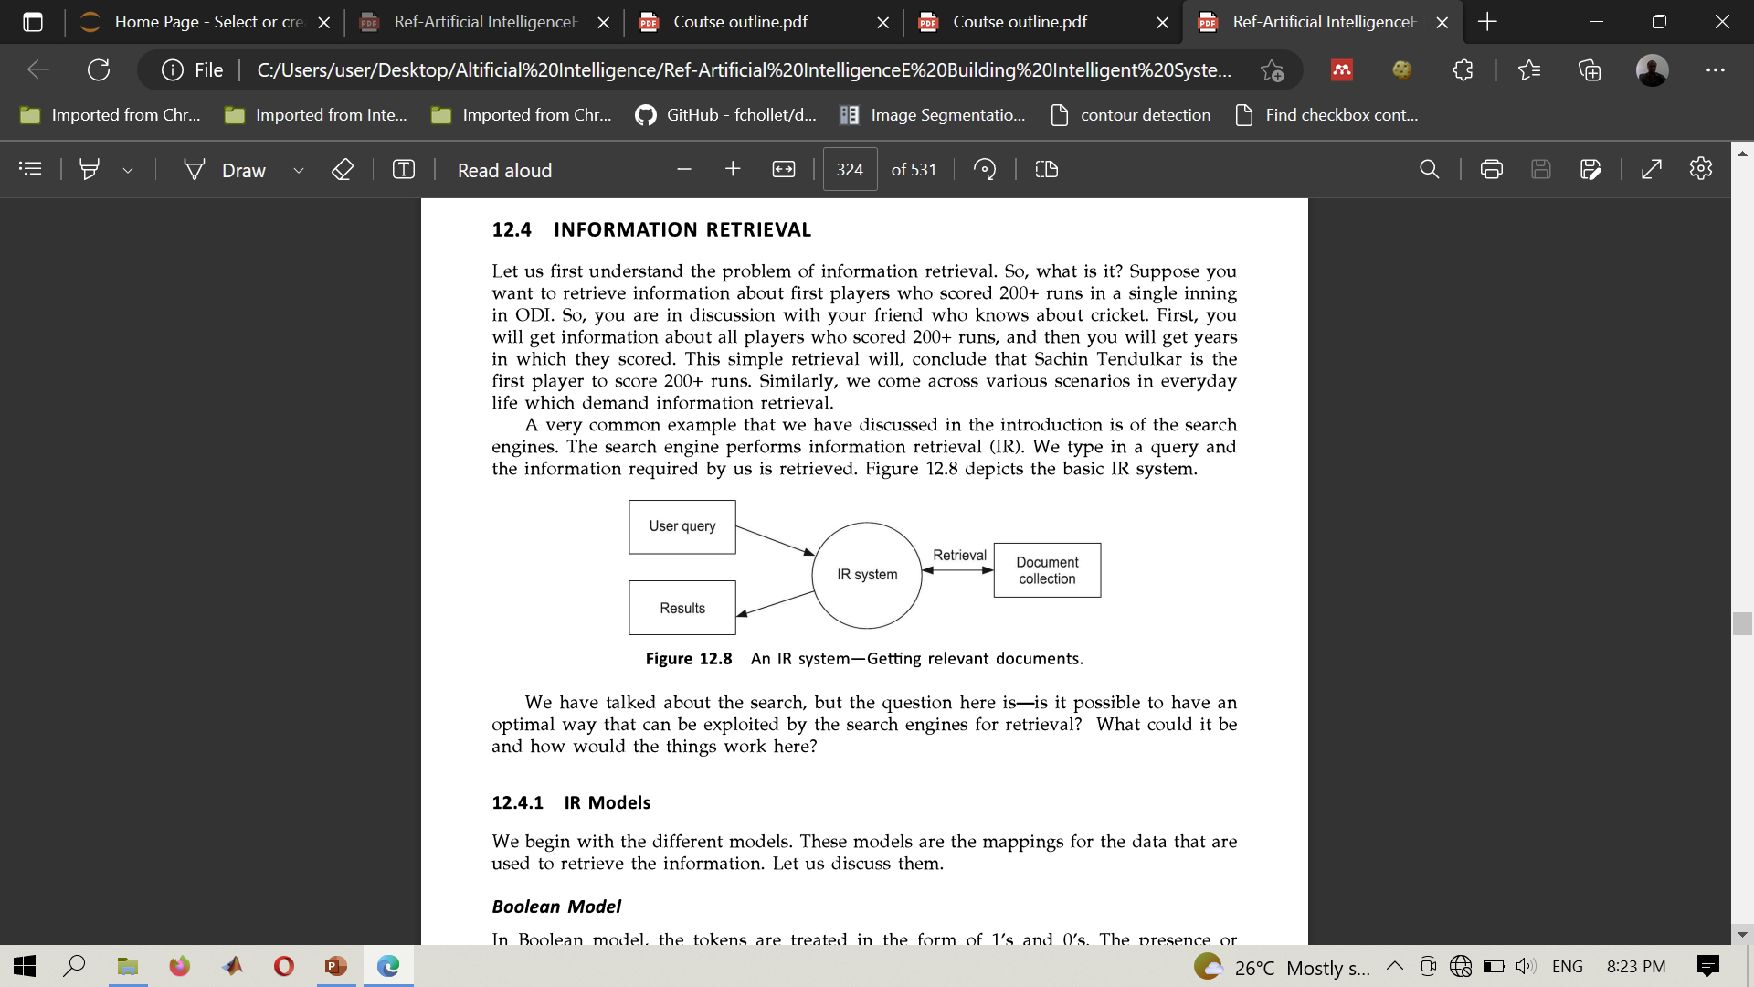
IR system

Slide 17
techniques used in information retrieval in NLP (H/W)
Vector Space Model:
This model represents each document and query as a vector in a high-dimensional space, where each dimension represents a term or word.
The similarity between a query and a document is computed using cosine similarity between their corresponding vectors.
Latent Semantic Indexing:
This technique uses Singular Value Decomposition (SVD) to reduce the dimensionality of the term-document matrix, and to capture the underlying semantic structure of the documents.
Probabilistic Retrieval Models:
These models use statistical models to estimate the relevance of a document to a query based on the probability of the query generating the document.
Neural Retrieval Models:
These models use neural networks to learn a mapping between a query and a document representation, and to compute the similarity between the two.

Slide 18

Information extraction
Information Extraction (IE) is a subfield of NLP that involves automatically extracting structured information from unstructured or semi-structured text data.
  The goal of IE is to identify specific pieces of information, such as named entities, relationships between entities, and events, from large collections of text data which can be used to improve decision-making, automate workflows, and enhance user experience.
  Information Extraction is a critical task in many NLP applications, such as information retrieval, question answering, and knowledge management.

Slide 19
examples of Information Extraction in NLP
Named Entity Recognition (NER):
NER involves identifying and classifying named entities in text data, such as people, organizations, locations, dates, and other types of entities.
For example, in the sentence “Mwl J. Nyerere was born in Butiama in 1922", NER would identify “Mwl. J Nyerere" as a person, “Butiama" as a location, and “1922" as a date.
Relation Extraction:
Relation Extraction involves identifying the relationships between named entities in text data.
For example, in the sentence “Bill Gates founded Microsoft in 1975 ", Relation Extraction would identify that "Bill Gates" is the founder of "Microsoft", and that the relationship between them is "founded".
Event Extraction:
Event Extraction involves identifying events or actions described in text data, along with the participants and the time frame of the event.
For example, in the sentence "The company announced a new product launch next month", Event Extraction would identify that the event is a "product launch", the participants are "the company", and the time frame is "next month".
Template Filling:
Template Filling involves extracting specific information from text data and filling it into predefined templates.
For example, in a news article about a sports game, Template Filling would extract information such as the name of the teams, the score, the location, and the date of the game, and fill it into a pre-defined template.

Slide 20
Machine translation
Machine Translation (MT) is a subfield of NLP that involves automatically translating text from one language to another.
The goal of MT is to create a system that can accurately and efficiently translate text between different languages, without the need for human intervention.

Slide 21

example of how Machine Translation works
Pre-processing:
The input sentence would be pre-processed, which involves tokenization (breaking the sentence into words), part-of-speech tagging (assigning grammatical categories to each word), and morphological analysis (identifying word forms and inflections).
Alignment:
The system would align the source sentence (language_1) with the target language (language_2), which involves identifying the corresponding words and phrases in both languages.
Translation:
The system would translate each word or phrase in the source sentence into the target language, using a combination of rule-based, statistical, or neural machine translation techniques.
Post-processing:
The translated sentence would be post-processed, which involves reordering words, adjusting grammar, and adding punctuation to ensure that the translated sentence is grammatically correct and coherent.

Slide 22
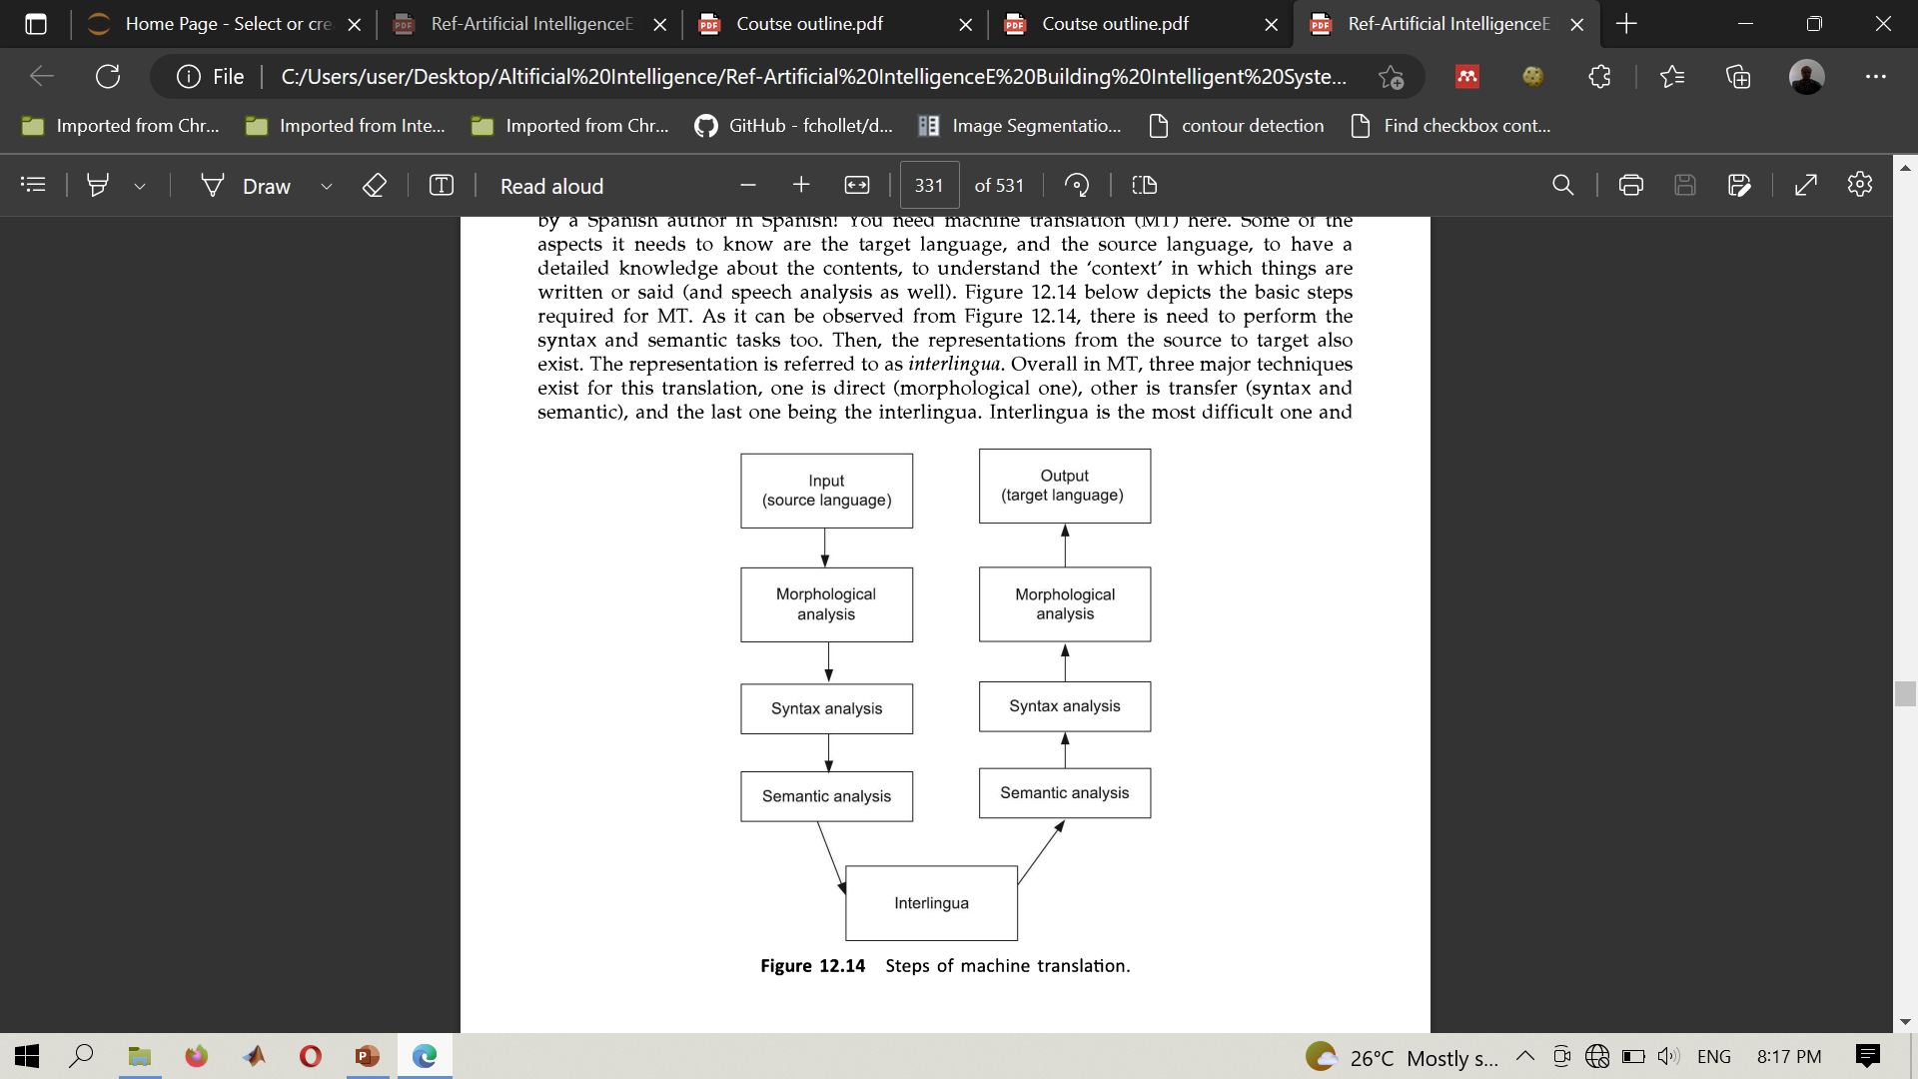
Steps of machine translation

Slide 23
end

